Slide 1

Stock Prediction of Yes Bank
Submitted by :- Sudhanshu Kumar Singh

Slide 2

Introduction
Stock market analysis of Yes Bank Stock with the help of python programming.
The data was analyzed with Time Series.
Taking the data from Yahoo.
There were 878 rows × 6 column in whole data.
The data is from 1-Jan-2016 to 25-July-2019.

Slide 3
OBJECTIVE
To find out the future predication of Yes Bank Stock market.
To analyze the stock price of Yes Bank.
To Summaries weekly and monthly averages and plot.
Plot open and closing rates.
Forecast next periods rates using any forecasting methods - Moving Average, ARIMA etc.
Additional plots to be explored - candlestick diagrams, heat map.

Slide 4
Stock price of yes bank
 | High | Low | Open | Close | Volume | Adj Close
Date
2019-07-18 | 90.250000 | 79.150002 | 88.599998 | 85.800003 | 229258092.0 | 85.800003
2019-07-19 | 86.900002 | 82.599998 | 86.000000 | 83.250000 | 145863654.0 | 83.250000
2019-07-22 | 92.500000 | 81.699997 | 83.300003 | 91.150002 | 208758719.0 | 91.150002
2019-07-23 | 93.900002 | 87.099998 | 89.000000 | 90.650002 | 164958204.0 | 90.650002
2019-07-24 | 93.650002 | 88.150002 | 0.000000 | 89.150002 | 103986283.0 | 89.150002

Slide 5
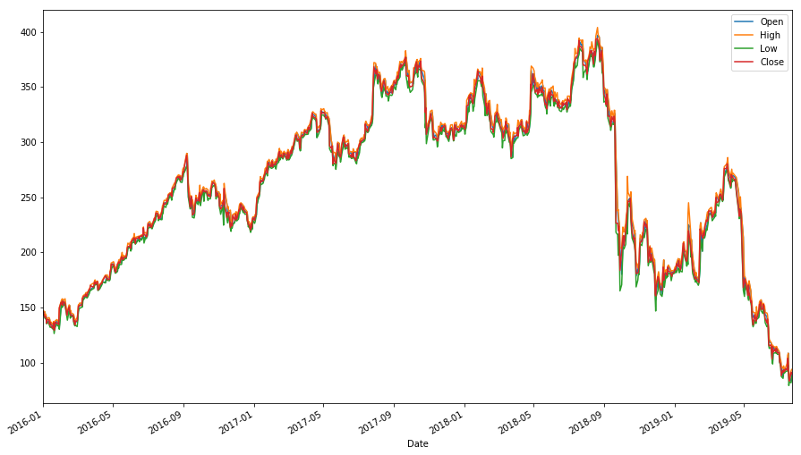
The graph of Stock prices

Slide 6
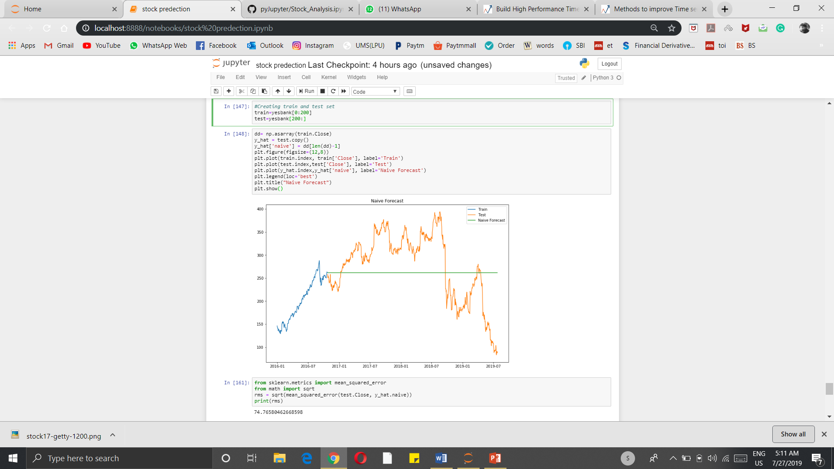
Naive Forecast
Estimating technique in which the last period's actuals are used as this period's forecast, without adjusting them or attempting to establish causal factors. It is used only for comparison with the forecasts generated by the better (sophisticated) techniques.

Slide 7
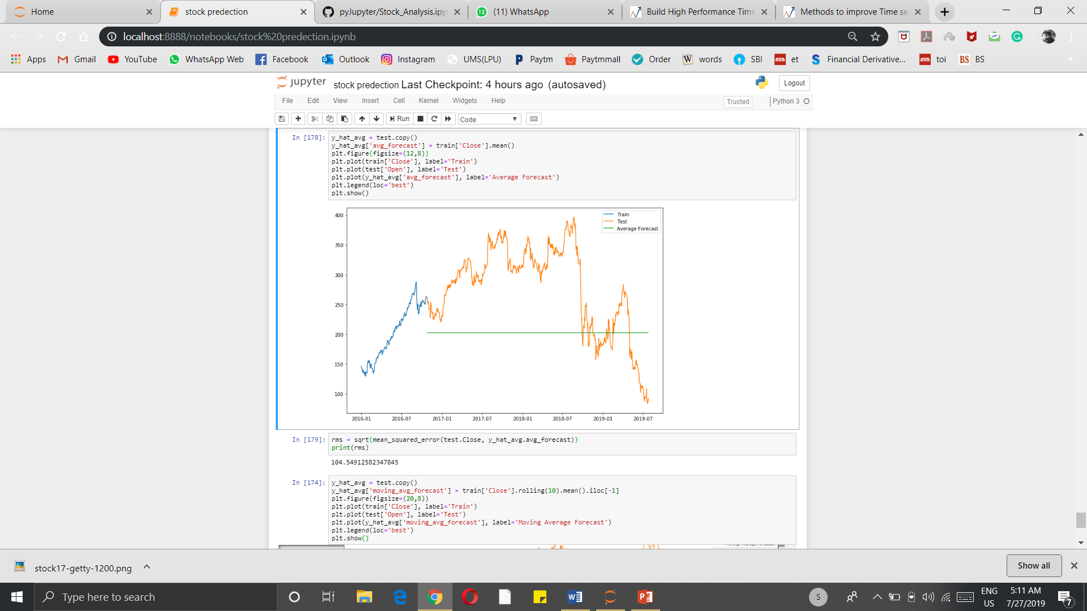
Average forecasting
A moving average is a technique to get an overall idea of the trends in a data set; it is an average of any subset of numbers. The moving average is extremely useful for forecasting long-term trends. You can calculate it for any period of time. For example, if you have sales data for a twenty-year period, you can calculate a five-year moving average, a four-year moving average, a three-year moving average and so on.

Slide 8
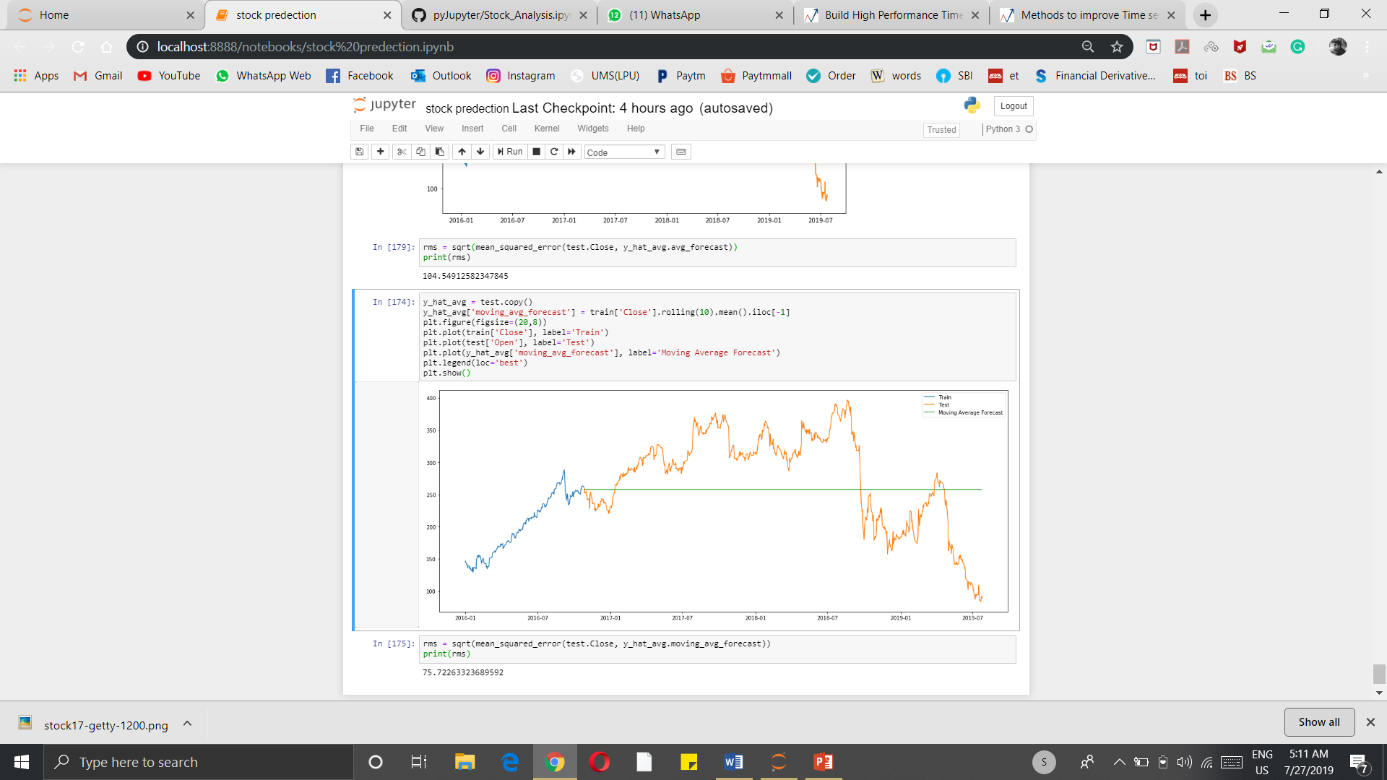
Moving average method
The moving average is extremely useful for forecasting long-term trends. You can calculate it for any period of time.

Slide 9
Suggestion
If you are buying for short period of time then avoid to buy share of Yes Bank.
If you are Buying for Long Period of time then you can buy the share of Yes Bank

Slide 10
Thank you

